Slide 1
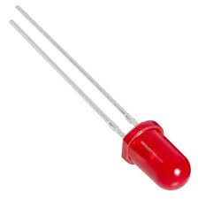
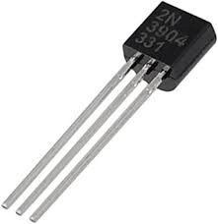
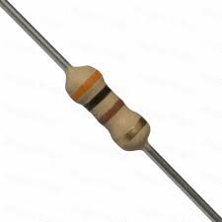
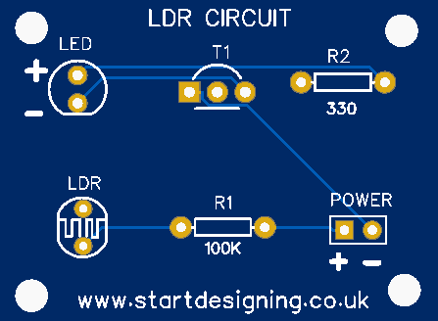
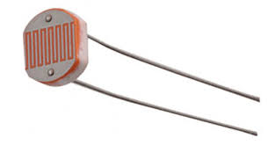
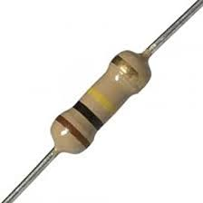
Component placement
Light
(You need to make sure the positive pin goes to the + hole)
Transistor
(Make sure the shape of the Transistor matches the white outline)
300R Resistor
(Does not matter which way round the pins go)
Orange, Black, Brown, Gold
Light Dependent Resistor
(Does not matter which way round the pins go)
Power source
(Make sure the positive lead goes to the + hole)
100k Resistor
(Does not matter which way round the pins go)
Brown, Black, Yellow, Gold

Slide 2
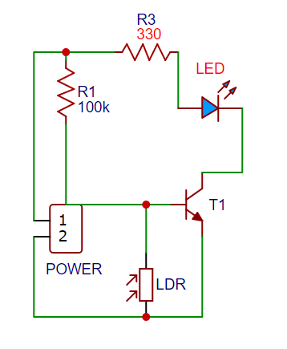
Circuit Diagram

Slide 3
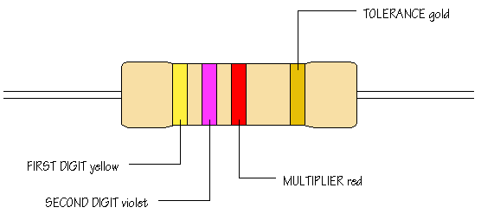
R = resistance
+/- 5%
OR silver
+/- 10%
0
1
Yellow = 4
2
3
Violet = 7
4
47 00
(ohms)
4.7 k
5
Tells how many ‘0’ you should write after the digits you already have: Red = 2 = 00
6
7
8
9
The letter K means kilo-ohm = 1000 ohms.
Notes:
http://www.doctronics.co.uk/resistor.htm
http://www.electronicshub.org/resistors/

Slide 4
Name the components:
Could you remember how to identify LED positive and negative side?
Calculate the value of each Resistor:
?
?
0
1
2
3
4
5
6
7
8
9
Notes:
Brown-black-black = 10 ohms; brown-black-brown = 100 ohms; green-blue-black = 56 ohms

Slide 5
Calculate the value of each Resistor:
0
1
2
3
4
5
6
7
8
9
Notes:
Br-gr-black=18, gr-red-blac=82, yel-viol-bl=47, brow-red-bl=12, red-viol-bl=27, or-wht-bl=39
http://en.wikipedia.org/wiki/Electronic_color_code

Slide 6
PCB Component List

Slide 7
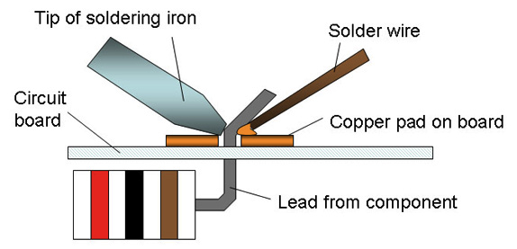
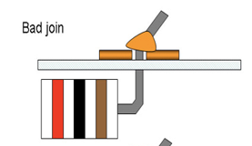
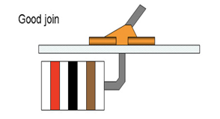
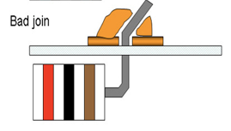
Soldering

Slide 8
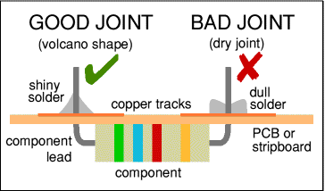

Slide 9
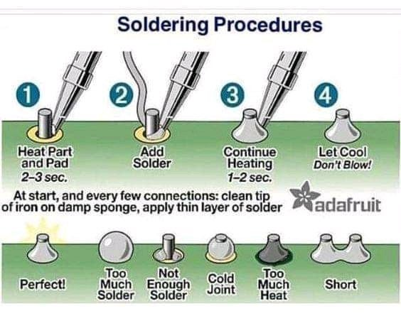

Slide 10
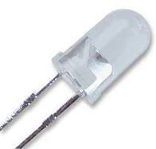
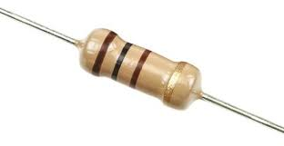
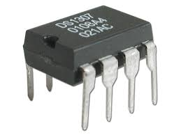
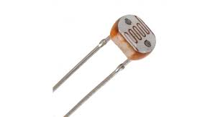
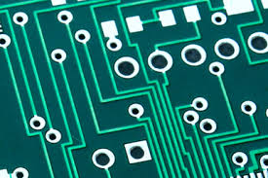
LED - A light-emitting diode that glows when electricity passes through it. They come in a range of colours.
Resistors restrict or limit the flow of current in a circuit and is measured in ohms.
Integrated circuit is a miniature circuit etched onto a piece of silicon, often called a chip.
Light dependent resistors, LDRs, are electronic components that are used to detect light & change the operation of a circuit dependent upon the light levels.
An integrated circuit (IC), sometimes called a chip or microchip, is a semiconductor wafer on which thousands or millions of tiny resistors, capacitors, and transistors are fabricated. An IC can function as an amplifier, oscillator, timer, counter, computer memory, or microprocessor..

Slide 11
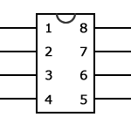
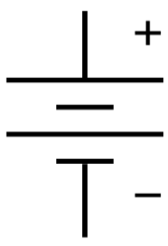
Name the components:
1
2
3
4
5
6
Did you know?
Solder is an alloy of tin and lead.
Notes:
http://www.khazar.com/academics/portal/ucsc/2010winter/art22/class05.php

